Slide 1
Model 2 Introduction to Cryptography
Lesson 3: Cryptographic Applications

Slide 2
Module 2: Introduction to Cryptography
Module Description:
This module provides an overview of cryptography. Students will be given an overview at first, such as different encryption methods. Then more details will be provided on symmetric cryptography and asymmetric cryptography, such as DES, AES, RSA. Another micro module talks about cryptographic applications that are widely used in the real world.
Topics:
Lesson 1: Cryptography Overview
Lesson 2: Symmetric and Asymmetric Cryptography
Lesson 3: Cryptographic Applications

Slide 3
Lesson 3: Cryptographic Applications
Topics:
Diffie-hellman, Hash, Message authentication, Digital Signature, Public key certificates, digital envelopes.
Learning Outcomes:
Upon completion of this lesson:
Students will be able to state how cryptography can be used, strengths and weaknesses.
Students will be able to describe the cryptographic applications, such as message authentication, public key certificates, digital signature.

Slide 4
Warm up
How to use checksum to validate the integrity of a letter?

Slide 5
Public key crypto to exchange secret keys
In symmetric encryption, a secret key is used for encryption and decryption.
How to share the key?
To establish an encrypted session, you need an encrypted methods to exchange keys.
Public key cryptography can help!

Slide 6
Diffie-Hellman Key Exchange
The Diffie-Hellman key agreement protocol was developed by Diffie and Hellman in 1976
The protocol allows two users to exchange a secret key without any prior secrets.
First public key algorithm
Based on discrete log problem where want to find a value of k such that
n = gk mod p for a given n, g, and prime number p
Difficulty increases exponentially as p increases

Slide 7
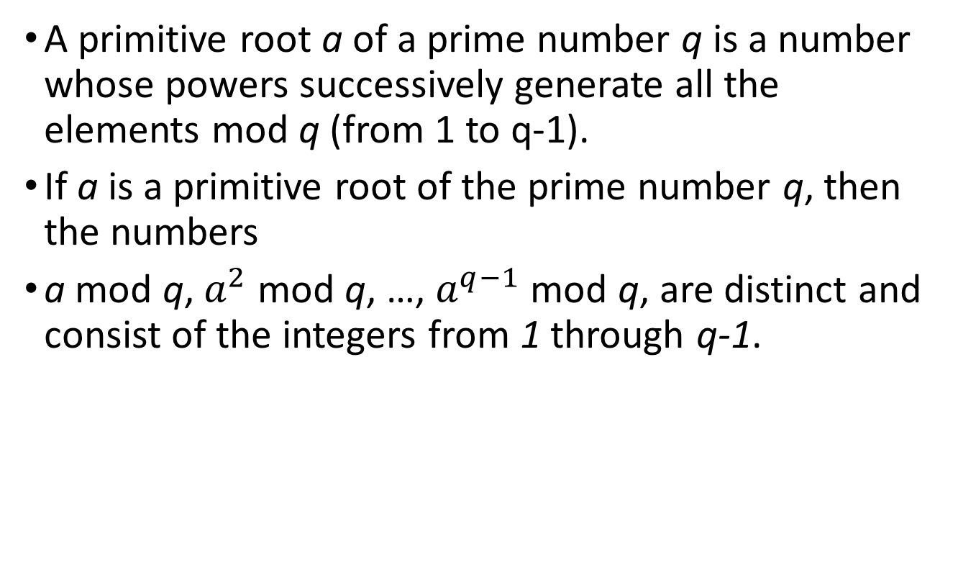
Primitive root
A primitive root a of a prime number q is a number whose powers successively generate all the elements mod q (from 1 to q-1).
If a is a primitive root of the prime number q, then the numbers
a mod q, $a^{2}$ mod q, …, $a^{q−1}$ mod q, are distinct and consist of the integers from 1 through q-1.

Slide 8
Primitive root example
Example:
a = 3
q = 7

Slide 9
Diffie-Hellman
Example:
Alice and Bob share “public” keys
They agree on two large numbers: n, g (can be publicly known numbers)
n should be a prime number (at least 512 bits)
1 < g < n and g is a primitive root of n
The Private Keys
Alice needs a private key
She chooses a large random integer, x
Bob needs a private key
He also chooses a large random integer, y

Slide 10
Diffie-Hellman exchange part 1 - Alice
Exchange, part 1
Alice uses her private key and the public keys to compute X:
X = g ^{x} mod n
Alice sends X to Bob
g, n are public known
x private to Alice
X sent to Bob

Slide 11
Diffie-Hellman exchange part 1 - Bob
Exchange, part 1
Bob uses his private key and the public keys to compute Y:
Y = g ^{y} mod n
Bob sends Y to Alice
g, n are public known
y private to Bob
Y sent to Alice

Slide 12
Diffie-Hellman exchange part 2 - Alice
The Exchange, part 2
Alice uses her private key and Y from Bob to compute k1 (key):
k1 = Y ^{x} mod n
g, n are public known
x private to Alice
Y is sent from Bob

Slide 13
Diffie-Hellman exchange part 2 - Bob
The Exchange, part 2
Bob uses his private key and X from Alice to compute k2 (key):
k2 = X ^{y} mod n
g, n are public known
y private to Bob
X is sent from Alice

Slide 14
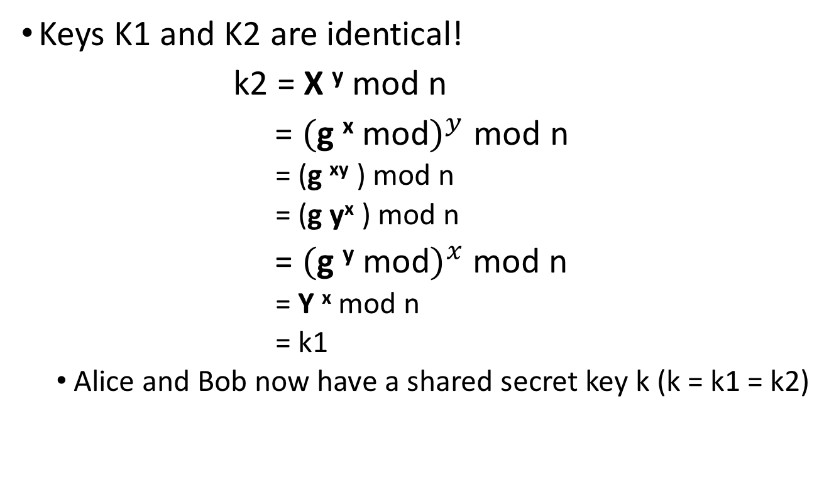
Diffie-Hellman example
Keys K1 and K2 are identical!
k2 = X ^{y} mod n
= $($g ^{x} mod$)^{y}$ mod n
= (g ^{xy} ) mod n
= (g y^{x} ) mod n
= $($g ^{y} mod$)^{x}$ mod n
= Y ^{x} mod n
= k1
Alice and Bob now have a shared secret key k (k = k1 = k2)

Slide 15
Diffie-Hellman
The protocol depends on discrete logarithm problem for its security.
It assumes that it is computationally infeasible to calculate the shared secret key
Even if an attacker can obtain n, g, X, Y he cannot directly compute k1=k2

Slide 16
Man-in-the-middle attack
An attack on the authentication protocol run in which the Attacker positions himself in between the Claimant and Verifier so that he can intercept and alter data traveling between them.

Slide 17
Hash function
A function that maps a bit string of arbitrary length to a fixed length bit string. Approved hash functions satisfy the following properties:
1) One-Way. It is computationally infeasible to find any input that maps to any prespecified output.
2) Collision Resistant. It is computationally infeasible to find any two distinct inputs that map to the same output.

Slide 18
Message Authentication Code
Message authentication code - A cryptographic checksum on data that uses a symmetric key to detect both accidental and intentional modifications of the data. MACs provide authenticity and integrity protection, but not non- repudiation protection.
Message or data authentication is a procedure that allows communicating parties to verify that received contents have not been altered and the source is authentic .

Slide 19
Hash function requirements
1. Hash function can be applied to a block of data of any size.
2. It should produce a fixed-length output.
3. The hush function should be easy to compute .
4. For any hash total h, it is computationally infeasible to find x such that H(x) = h. (one-way hash)
5. It is computationally infeasible to find any pair (x, y) such that H(x) = H(y). (strong collision resistant)

Slide 20
Digital Signatures
Digital signature - An asymmetric key operation where the private key is used to digitally sign data and the public key is used to verify the signature. Digital signatures provide authenticity protection, integrity protection, and non-repudiation.
Used for authenticating both source and integrity of data
Does not provide confidentiality.

Slide 21
Digital Signatures example
Suppose that Bob wants to send a message to Alice. Digital signature can be used to ensure the message is truly from Bob.
Bob uses a secure hash function to generate a hash value for the message, and then encrypts the hash value with his private key, creating a digital signature. Then the message and the digital signature will be sent to Alice
When Alice receives the message and the digital signature, she will
Calculates a hash value for the message, decrypts the digital signature, and then compares her calculated hash value with the one received from Bob.

Slide 22
Digital Signatures example (cont.)
If the two hash values match, then Alice can assure:
The message must have been signed by Bob. (Because no one knows Bob’s private key)
The message has not been altered. Otherwise the hash value will be changed.
So the message is authenticated both in terms of source and in terms of integrity of data.

Slide 23
Public key encryption issues
The point of public-key encryption is that the public key is public. so some user could pretend to be someone and send a public key to another participant or broadcast the public key.
The solution to this problem is the public-key certificate.
A user can present his or her public key to the authority in a secure manner and obtain a signed certificate. The user can then make certificate publicly available.
Anyone needing this user’s public key can obtain the certificate and verify that the attached signature.

Slide 24
Certificate
A digital representation of information which at least
1) identifies the certification authority issuing it, 2) names or identifies its subscriber, 3) contains the subscriber's public key,
4) identifies its operational period, and 5) is digitally signed by the certification authority issuing it.
Certification Authority (CA) – A trusted entity that issues and revokes public key certificates, such as a government agency or a financial institution.

Slide 25
Public-key Certificate steps
1. User creates a pair of keys: one public and one private
2. User prepares an unsigned certificate that includes the user ID and public key and sends to a CA.
3. CA creates a signature:
CA uses a hash function to calculate the hash value of the unsigned certificate.
CA generates digital signature using the CA’s private key and a signature generation algorithm.
5. CA attaches the signature to the unsigned certificate to create a signed certificate.
6. CA returns the signed certificate to client.
7. Client may provide the signed certificate to the public.

Slide 26
Digital envelope
Digital Envelopes - Using a sealed envelope containing an unsigned letter, to protect the message.

Slide 27
Digital Envelopes steps
If Bob wants to send a message to Alice:
1. Prepare a message.
2. Generate a random one-time secret key.
3. Encrypt that message using symmetric encryption and the one-time secret key.
4. Encrypt the one-time secret key using public-key encryption with Alice’s public key.
5. Attach the encrypted one-time key to the encrypted message and send it to Alice.

Slide 28
Digital Envelopes
When Alice receives the encrypted one-time secret key and the encrypted message:
Only Alice is able to decrypt the encrypted one-time secret key by using her private key.
After decrypting the secret key, her can use the key to decrypt the message.
Therefore, only Alice can read the contents of the original message.

Slide 29
Summary
Topics:
Diffie-Hellman Key Exchange
Man-in-the-middle attack
Hash function
Message authentication
Digital signature
Public-key certificate
Digital envelope

Slide 30
Please attribute Dr. Jim Alves-Foss and Dr. Jia Song, University of Idaho
Except where otherwise noted, this work is licensed under https://creativecommons.org/licenses/by-nc-sa/4.0/ Not withstanding the non-commercial license terms, non-profit educational institutions are granted a non-exclusive license to adapt and use this material, with attribution. Creative Commons and the double C in a circle are registered trademarks of Creative commons in the United States and other countries. Third party marks and brands are the property of their respective holders.
Project sponsored by the National Security Agency under grant Number H98230-17-1-0199. The United States Government is authorized to reproduce and distribute reprints notwithstanding any copyright notation herein.

